Slide 1


Human Rights
NORTHWIND TRADERS
Teacher Name: Faisal
Presented by:
Syed Wasif (25F-CY-060)
Muhammad Yousuf (25F-CY-085)
Abdul Rehman (25F-CY-105)

Slide 2
Agenda:
Introduction (HR)
History (UDHR)
Core Rights
Pakistan's Constitution
Human Rights Situation in Pakistan
Current Challenges
Global human rights violation
Implementation Gap
Conclusion

Slide 3

Introduction
Definition: human rights are basic rights that belong to every individual simply because they are human.
Key characteristics: Universal: same for everyone, everywhere.
Inherent: you are born with them; they aren't granted by governments.
Indivisible: you cannot pick and choose; all rights (social, civil, economic) are equal.
Core value: to ensure every person lives with dignity and freedom.

Slide 4
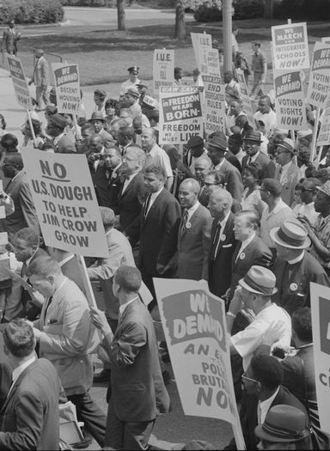
History
Origin: Adopted on December 10, 1948, by the United Nations (UN) after World War II.
The Document:. The Universal Declaration of Human Rights (UDHR) consists of 30 Articles
Significance: It is the first global agreement that defines what a "decent life" looks like for every human.

Slide 5

Core Rights (The Essentials):
Right to Life & Liberty: Protection against arbitrary harm or imprisonment.
Freedom of Expression: The right to speak, write, and share ideas.
Right to Equality: No discrimination based on race, gender, or religion.
Right to Education & Health: Access to basic learning and medical care as a fundamental necessity. preferences.

Slide 6
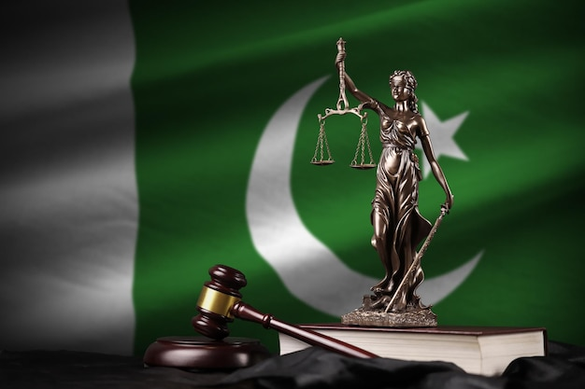
Human Rights in Pakistan's Constitution:
The 1973 constitution: part II (articles 8–28) defines “fundamental rights.”
Key provisions:
Article 9: security of a person.
Article 19: freedom of speech and press.
Article 25-A: right to free and compulsory education (aged 5–16).
Article 20: freedom to profess religion (minority protection).
Latest update (2025-26): the 27th amendment (Nov 2025) further defined legal protections and constitutional bench jurisdictions.

Slide 7

Human Rights Situation in Pakistan (2026)
Institutional Role: The National Commission for Human Rights (NCHR) is actively monitoring violations.
Positive Steps: Increased focus on "Gender-Based Violence" (GBV) courts and the ICT Child Marriage Restraint Act (2025).
Digital Evolution: As of April 2026, the discussion has shifted toward Data Privacy and protection against online harassment.

Slide 8
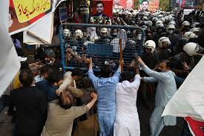
Current Challenges (Pakistan Specific)
Freedom of Press: Ongoing debates regarding internet regulations (firewalls) and social media monitoring.
Economic Rights: High inflation in 2026 has made "Right to Food" and "Right to Health" difficult for the low-income class.
Forced Conversions & Minorities: Ensuring the safety of minority communities remains a top challenge for law enforcement.
Climate Justice: Pakistan is facing severe weather patterns (2026 heatwaves/floods), impacting the "Right to a Safe Environment."

Slide 9
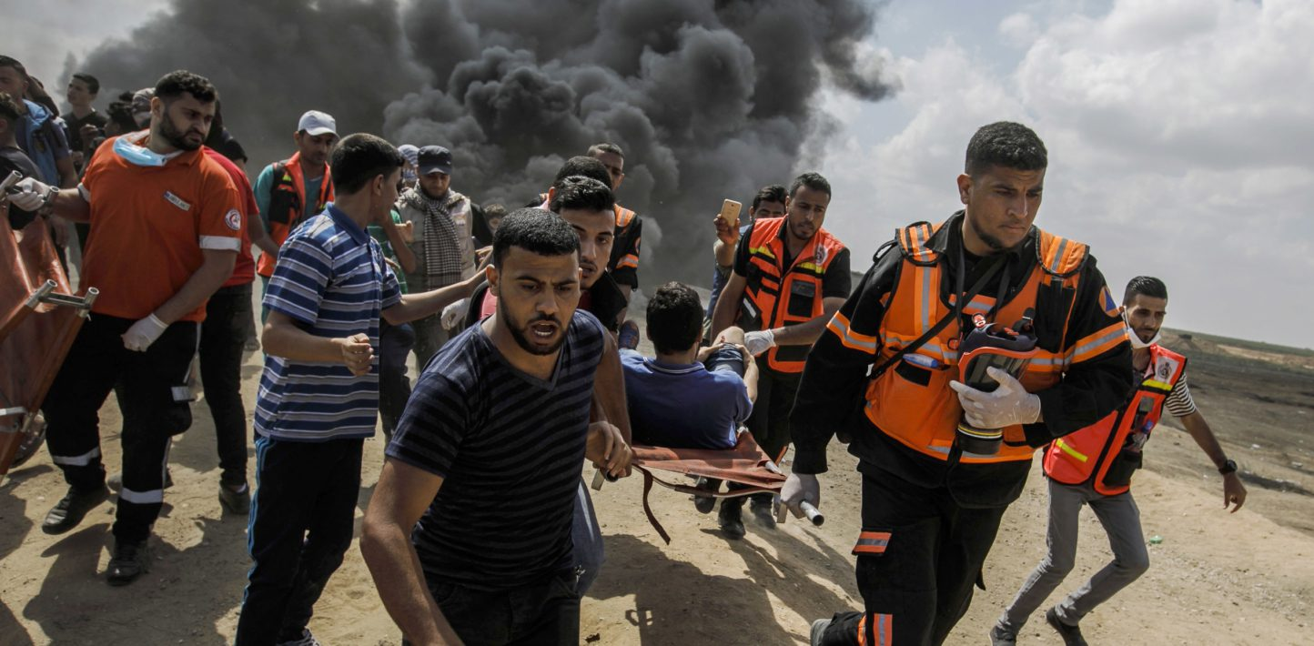
Global Human Rights Violations
Conflict Zones: Ongoing humanitarian crises in Sudan, Gaza, and Lebanon where civilian protection is failing.
Refugee Crisis: Over 239 million people globally (2026 report) need urgent protection due to war and climate change.
Justice Systems Failure: A 2026 UN Women report highlights that 54% of countries still have gaps in defining crimes like rape based on consent.
Our financial overview reflects a robust and resilient fiscal performance.
Operating margins have improved, signaling operational efficiency, while strengthening our reserves.

Slide 10
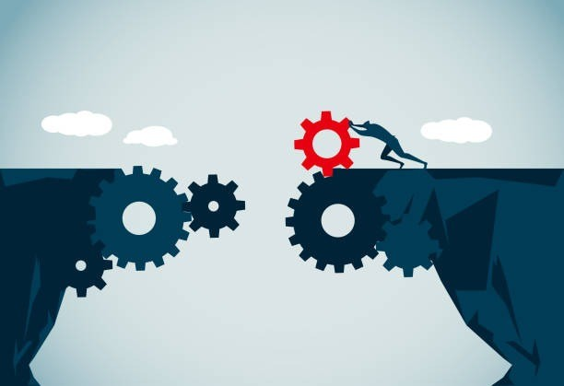
The Implementation Gap
The Problem: Laws exist on paper, but why do violations continue?
Lack of Awareness: People don't know their rights (Article 25-A or Article 9).
Slow Judicial System: Cases take years to resolve, denying "Right to a Fair Trial.“
Funding: UN Human Rights Appeal 2026 shows that human rights initiatives are globally underfunded.
Social Norms: Cultural practices often override legal protections (e.g., child labor).

Slide 11

Conclusion
Summary: Human rights are the backbone of a stable society.
The Way Forward: Focus on Education, Legal Reform, and Digital Rights.
Final Thought: "Justice delayed is justice denied." We must ensure implementation, not just legislation.

Slide 12

THANK YOU Regards: Syed Wasif (25F-CY-060) Muhammad Yousuf (25F-CY-085) Abdul Rehman (25F-CY-105)

